Slide 1
TypeScript JavaScript + NXT
@basarat
Google it

Slide 2
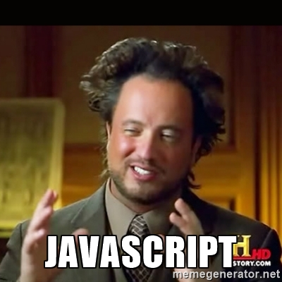

Slide 3
LESS WAT

Slide 4

WAT

Slide 5

AWWW

Slide 6

WAT

Slide 7
JavaScript
[].asdf()
TypeError:
[].asdf is not a function

Slide 8
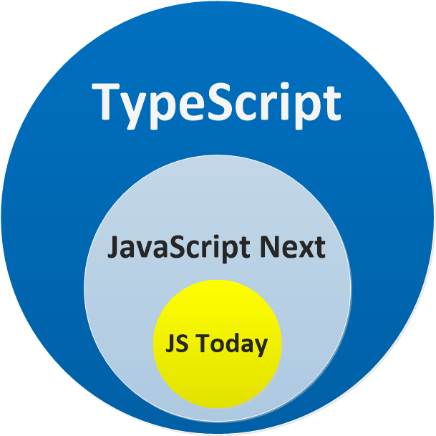

Slide 9
DEMO
Just a JS file
A JS Project

Slide 11


Slide 12


Slide 13


Slide 15
QUESTIONS

Slide 16


alm.tools
Google:
TypeScript Book

Slide 17
@basarat

